Slide 1
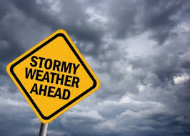

Disaster preparedness at work and at home
Anne Widney, Emergency Services Manager
UC Irvine Police Department

Slide 2
Agenda
Disaster Preparedness at UC Irvine
  Emergency Services Unit
  Top Hazards
  Planning Efforts
  EOC/DOC Operations
  Responsibilities of Students/Staff/Faculty
Personal Preparedness
  Know Your Risks
  Have A Kit
  Make A Plan
  Be Informed
  Get Involved
  Special Considerations

Slide 3
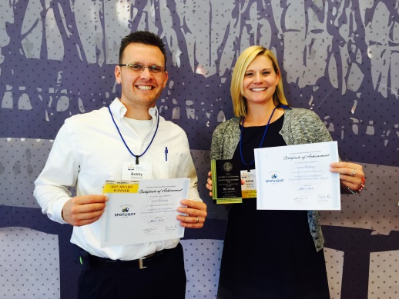
Emergency Services Unit
2 Full Time Employees
  Emergency Services Manager
  Business Continuity Planner
Key Programs
  Crisis Management
  Emergency Planning and Program Management
  Business Continuity Planning
  Emergency Operations Center (EOC) and Department Operations Center (DOC) Coordination
  Zone Crew
  Campus Search and Rescue (CSAR)

Slide 4
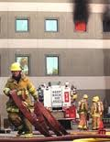
What keeps us up at night….
Top 5 Hazards
Catastrophic Earthquake
Lab or Building Fire
Civil Disturbance/Protest
Public Health Outbreak/Pandemic
Active Shooter/Workplace Violence
And… chemical/radiological/biological/nuclear incident, technology/utilities failures, wildfires, floods…

Slide 5
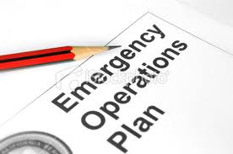
Planning efforts
Emergency Operations Plan (EOP)
Guide to Emergency Communications Across Campus
Chancellor’s Executive Policy Group (CEPG)
Emergency Operations Center (EOC)
Department Operations Centers (DOCs)
  EH&S
  FM
  OIT
  PD
  Student Affairs
  Student Housing

Slide 6
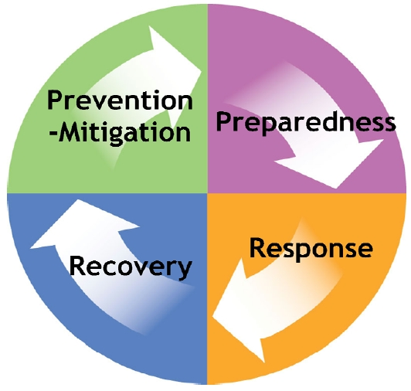
All-Hazards emergency management

Slide 7

Campus exercises
The Great California ShakeOut
  Every October – practice Drop, Cover, & Hold On
  Building/School-wide Evacuation Drills
  2015 – October 15th at 10:15 AM
EOC & DOC Exercises
BSL3 Lab
Reactor
Police Department

Slide 8

Roles & responsibilities
Sign up for zotALERT
Know Your Zone Crew & Assembly Area
Emergency Procedures Flip Charts
  What To Do In The Event Of….
    Earthquake
    Fire
    Utility Failure
    Active Shooter
    HazMat Incident
    And more!
Emergency Supplies
UC Ready Business Continuity Plan
Emergency Action Plan (EAP)
UCIPD Site Security Assessment

Slide 9
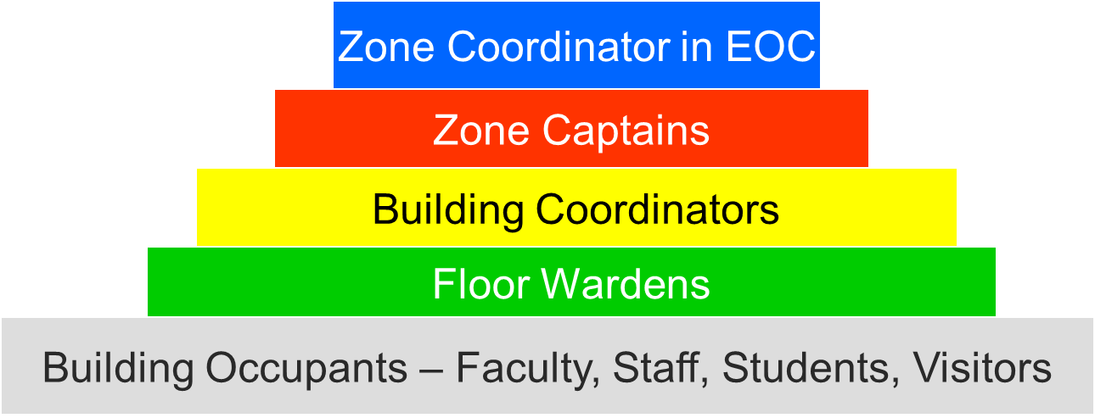
Zone Crew & Assembly Areas
13 Zones on Campus
Zone Crew Structure
Campus Evacuation Zones/Assembly Areas
  http://www.ehs.uci.edu/em/zonemap.html

Slide 10
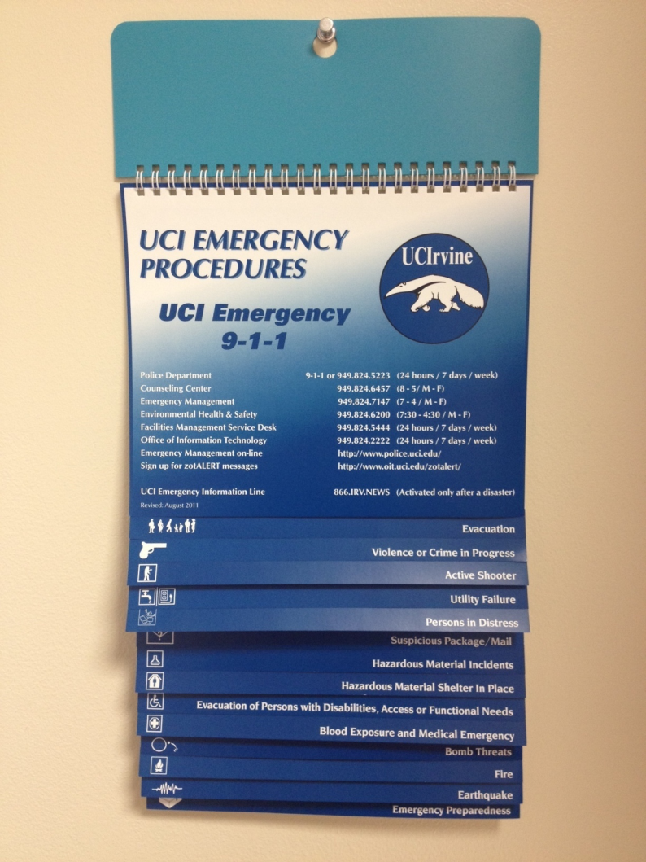
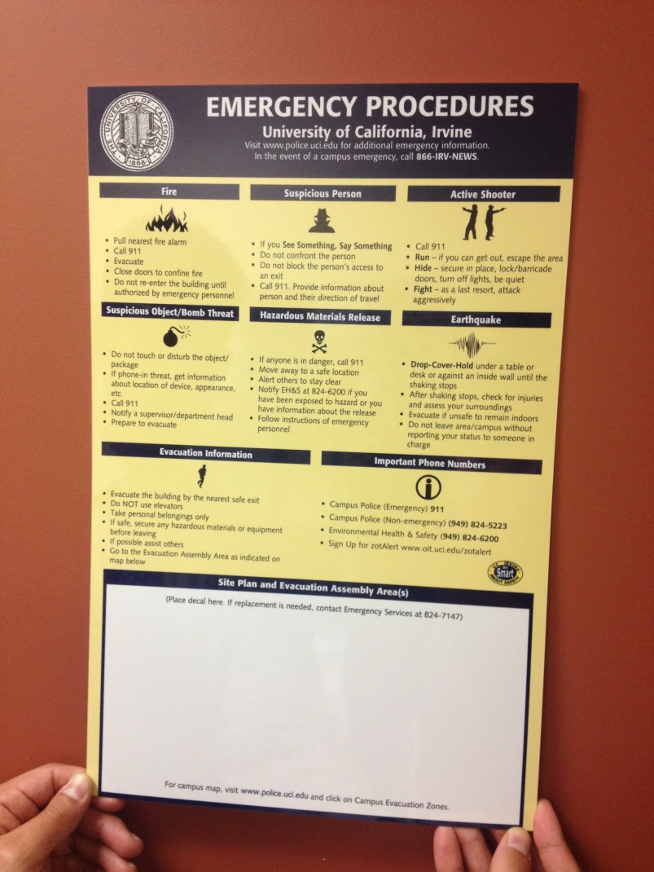
Emergency procedures

Slide 11
Emergency notification
zotALERT text messages
ZotMail email messages
Desktop notifications/Smart classrooms
UCI Emergency Hotline: 866-IRV-NEWS
Zot Radio WQTB 1690 AM
KUCI 88.9 AM
Social Media
  Facebook http://facebook.com/UCIrvinePD
  Twitter http://twitter.com/UCIrvinePD
  Nixle http://nixle.com/University-of-California-Irvine-Police-Department
Zone Crew
Other Campus Staff/Faculty

Slide 12
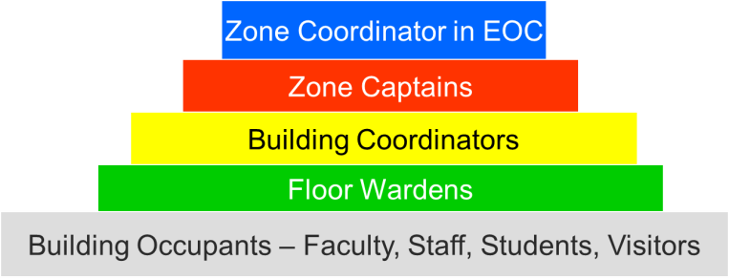
Zone crew
Follow the guidance provided by Zone Crew
Red Vests – Zone Captains
Yellow Vests – Building Coordinators
Green Vests – Floor Wardens
Assist with Evacuation, Secure-In-Place, Shelter-In-Place

Slide 13

evacuation
Evacuate when:
  A fire and/or life safety emergency occurs,
  The fire alarm activates,
  Notified to do so by emergency response personnel or Zone Crew
Be aware of all exits from your area and building
When the fire alarm activates or you are told to leave, keep calm, walk quickly to the nearest marked exit and ask others to do the same. DO NOT RUN
DO NOT USE ELEVATORS
Assist persons with disabilities, access, or functional needs

Slide 14
evacuation
Bring class roster with you
Once outside, move to your designated assembly area
  Keep the class together
Notify emergency personnel if you suspect someone may be trapped in the building
Stay clear of first responders
DO NOT return until an all clear message is given and you are directed to do so

Slide 15

EARTHQUAKE
If you are inside:
  Drop, Cover, Hold On under a desk, table, or along an interior wall
  Protect your head, neck, and face
  Stay under cover until shaking stops
  DON’T RUN OUTSIDE
  Evacuate, only if you feel it is unsafe to stay inside
If you are outside:
  Move to an open area away from tall buildings, trees, power lines, or other falling hazards
  If you are in the car, pull to the side of the road and wait for the shaking to stop – don’t stop underneath a bridge or overpass

Slide 16
SECURE-IN-PLACE – POLICE ACTIVITY
When Secure-In-Place zotALERT is issued:
  Follow instructions from First Responders and/or Zone Crew
  Lock doors, close windows & blinds
  Turn off the lights and computer/printer equipment
  Silence your cell phones, remain calm and quiet
  Barricade doors if in immediate area of police activity
  STAY PUT!!! Until the ALL CLEAR is given
Active Shooter
  Call 911, if safe to do so
  Run – if you can get out, escape the area
  Hide – secure in place, lock/barricade doors, turn off lights, silence phones, and be quiet
  Fight – as a last resort, attack aggressively

Slide 17
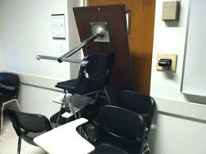
Secure-in-place – police activity
    What If I’m?
  OUTSIDE
    Seek shelter inside a building. If locked, move to next building.
    Continue until you find shelter or you are off campus
    If off campus, stay off campus until all clear message is received
  CLASSROOM/LECTURE HALL
    Notify classroom
    Lock or barricade doors
    If you hear fire alarm, don’t leave unless you see fire or smell smoke
    DO NOT LEAVE UNTIL AN ALL-CLEAR MESSAGE IS RECEIVED

Slide 18

SHELTER-IN-PLACE - HAZMAT
When Shelter-In-Place zotALERT is issued:
  Follow instructions from First Responders and/or Zone Crew
  Close doors and windows - seal with wet towels
  Shut off HVAC equipment if instructed to do so
  Close or seal air vents (if possible)
  Close window shades, blinds, curtains
  Move to a “Safe Interior Area”
    Away from doors and windows
    Think about conference rooms, break areas, restrooms
  Shut down experiments/operations
  STAY PUT!!! Until an all-clear message is given

Slide 19
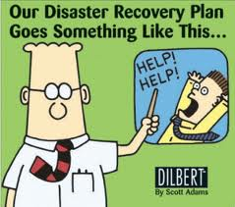

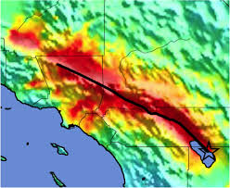
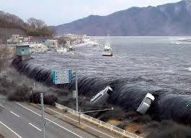
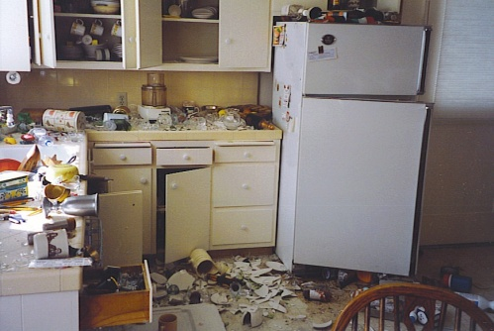
Personal preparedness
Could You and Your Family
Survive On Your Own,
Without Any Assistance,
for up to 10 Days?

Slide 20
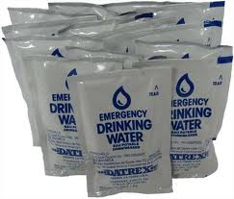
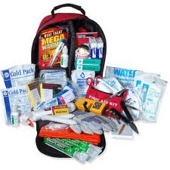
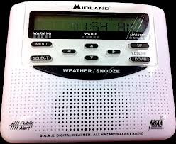
Have A Kit
In Your Car
At Work/School
At Home
10 Essential Supplies
  Water
  Food
  Can Opener
  Sturdy Shoes
  Flashlight/Batteries
  Copies of Important Documents
  First Aid Kit
  Medications
  NOAA Weather Radio
  Personal Care Items

Slide 21
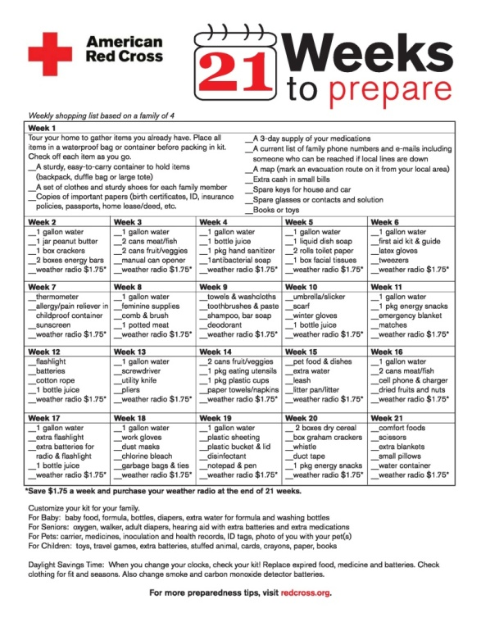
21 Weeks To prepare

Slide 22
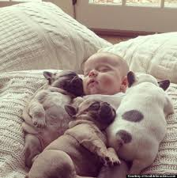
Special considerations
Children
  Activities
  Toys/Stuffed Animals
  Medical Records
Pets
  Collars/Leashes
  Crates
  Food/Treats/Toys
Disabilities, Access, and Functional Needs
  Medications
  Medical Equipment/Supplies
Elderly
  Medications
  Medical Equipment/Supplies
  Evacuation Time
  Transportation Considerations

Slide 23
Make A Plan
Talk With Your Family/Roommates
Have An Out Of State Contact
Text Messaging Instead of Phone Calls
Family Assembly Area
“ICE” Your Cell Phone
What About Fluffy and Fido?
Practice Your Plan
  Drop, Cover, Hold On – Earthquakes
  Stop, Drop, Roll – Fire
  Routes Out Of Your House
  Ways to Assembly Area
WINGING IT IS NOT AN EMERGENCY PLAN

Slide 24
Be Informed
What To Do Before, During, After a Disaster
Emergency Procedures Blue Flip Chart
City/County Emergency Plans
zotALERT
AlertOC
Social Media
  EM Blog http://sites.uci.edu/emergencymanagement/
  Facebook http://facebook.com/UCIrvinePD
  Twitter http://twitter.com/UCIrvinePD
  Nixle http://nixle.com/University-of-California-Irvine-Police-Department

Slide 25



Get involved
Volunteer with Zone Crew
Campus Search and Rescue (CSAR) Training
Community Emergency Response Team (CERT) Training
First Aid/CPR Training at the ARC
Fire Extinguisher Safety Training at EH&S
Citizen Corps/Medical Reserve Corps (MRC)
American Red Cross Volunteer Opportunities

Slide 26
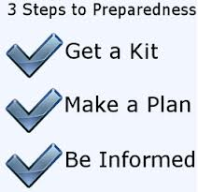
resources
American Red Cross
  http://www.redcross.org/
  Click on Disaster Services or Get Prepared
California Office of Emergency Services
  http://www.oes.ca.gov
Department of Homeland Security
  http://www.citizencorps.gov/
FEMA
  http://ready.gov/
Orange County
  http://readyoc.org/
  http://alertoc.org/

Slide 27
Questions?
Anne Widney, MPH
Emergency Services Manager
UC Irvine Police Department
949-824-7147 office
949-236-9682 cell
awidney@uci.edu

